Slide 1
Shopping
购物

Slide 2
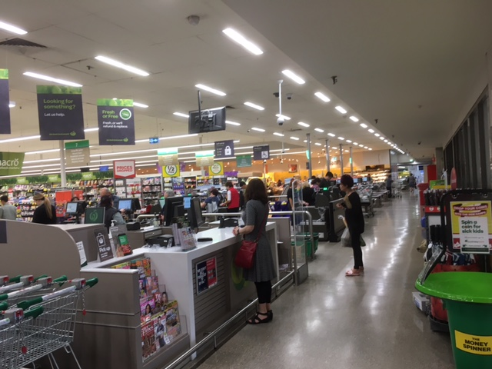
The front of the shop
Checkouts
Assisted checkout =
a shop assistant checks out your things
Self checkout =
You scan barcodes yourself and pay at the end
Enquiry Counter

Slide 3
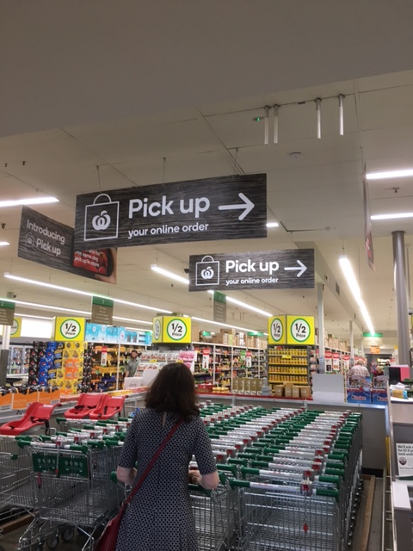
Buy things on the internet – on-line –
and come and collect ( pick up )them where the
arrow is pointing.

Slide 4
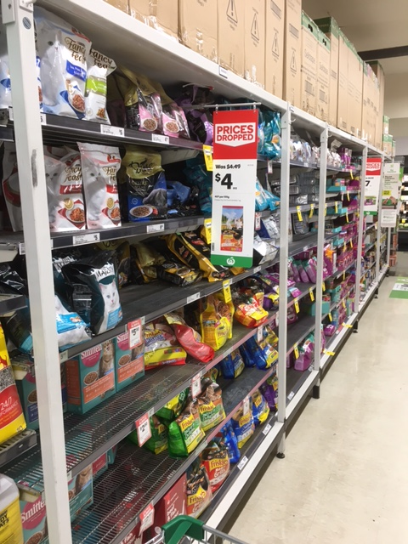
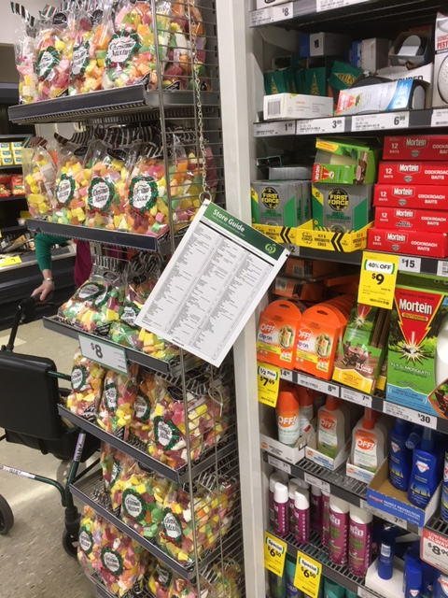
Store Guide
Shelves
Aisle

Slide 5
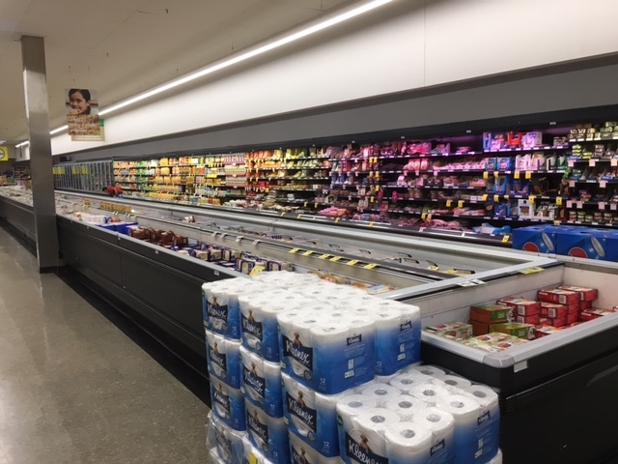
Side wall
Refrigerated and frozen goods

Slide 6
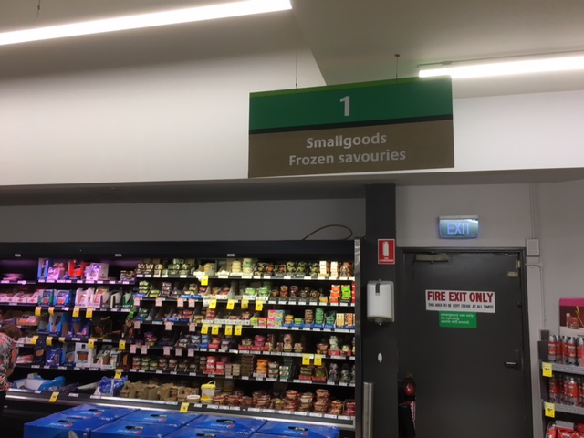
Smallgoods are not things that are small!
Smallgoods are things like sausages

Slide 7
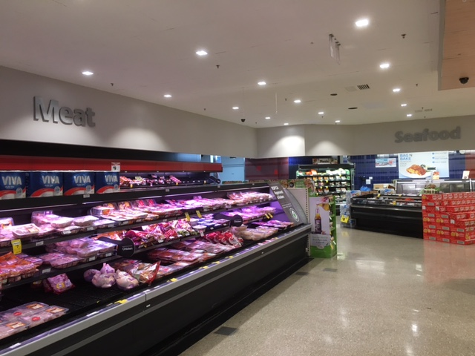
Meat Section

Slide 8
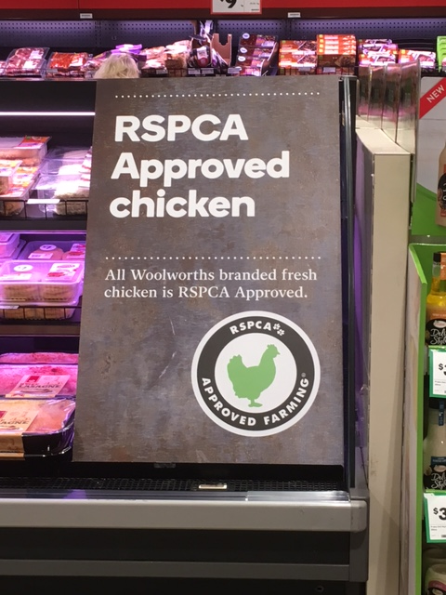
RSPCA = Royal Society for the Prevention of Cruelty to Animals

Slide 9
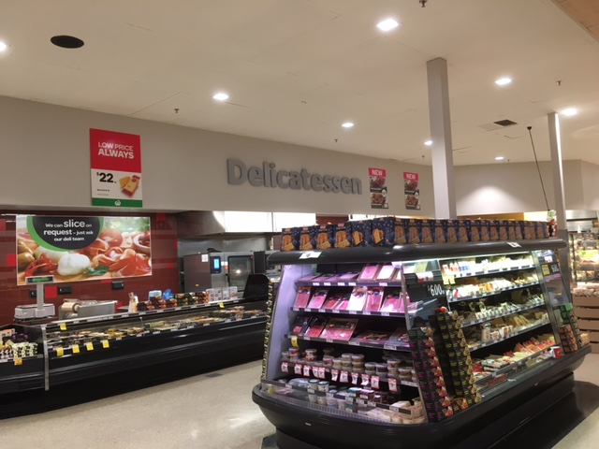
Delicatessen Section

Slide 10
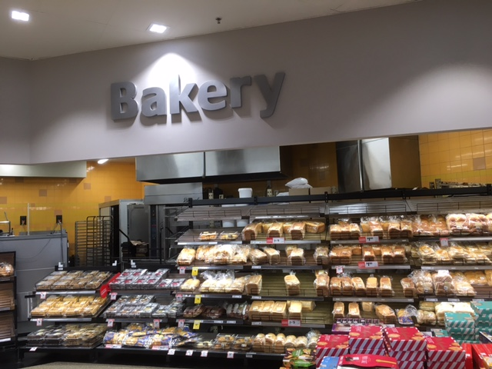
Bakery Section

Slide 11
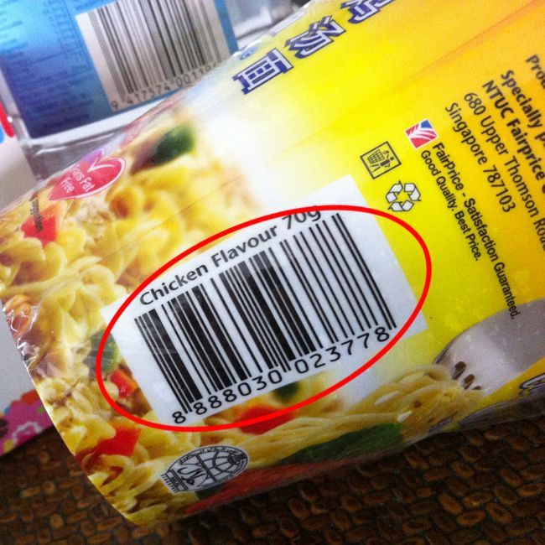
Barcode

Slide 12
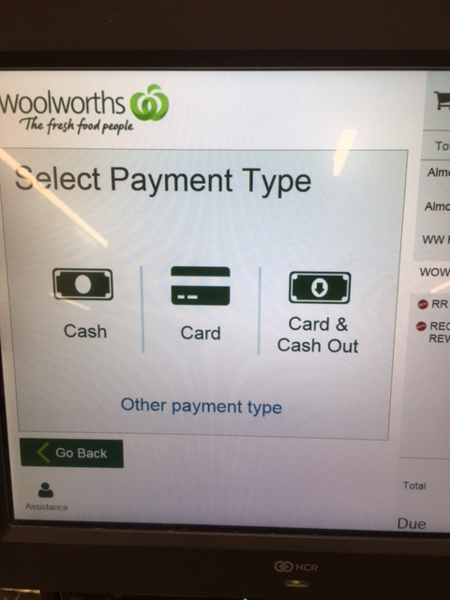
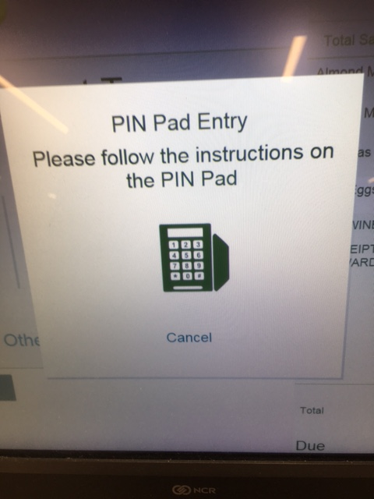
PIN = Personal Identification Number
When you select “Card” the computer voice says
“Follow the Pin Pad prompts to finalise your purchase”

Slide 13
Happy Shopping
Keep practising your English – remember to ask a person at the shop where something is -
You can ask the question:
The shop assistant might reply like this:
Excuse me. Can you tell me where …… is?
Excuse me, Do you sell …….?
Sorry to trouble you, but I’m looking for …..Do you sell it?
Hi. I can’t find where your …..is.
After getting an answer you can say “Thanks “
And the shop assistant might say “No worries”
OK it’s in Aisle 5 on the right hand side about shoulder height.
Yes we do. You’ll find it under Asian Foods Aisle 4 on the left hand side about half way down the Aisle.
Just go straight – its against the back wall in the Dairy Section
It’s over in the far corner near the Meat Section

Slide 14
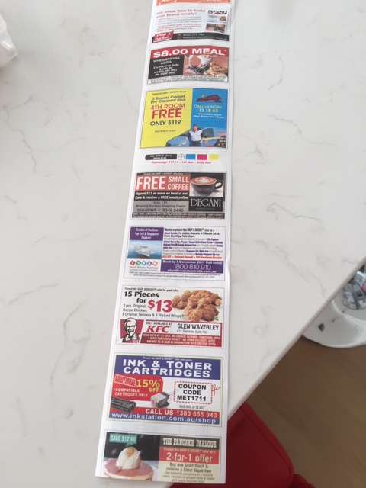
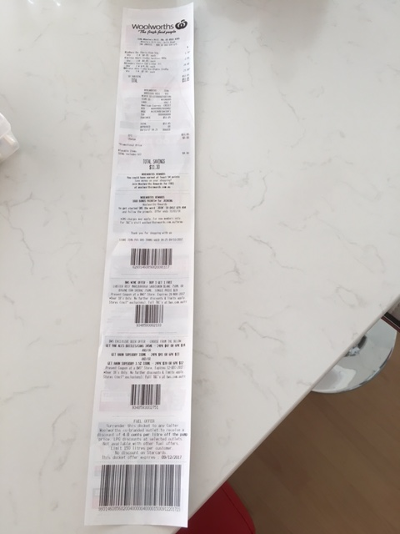
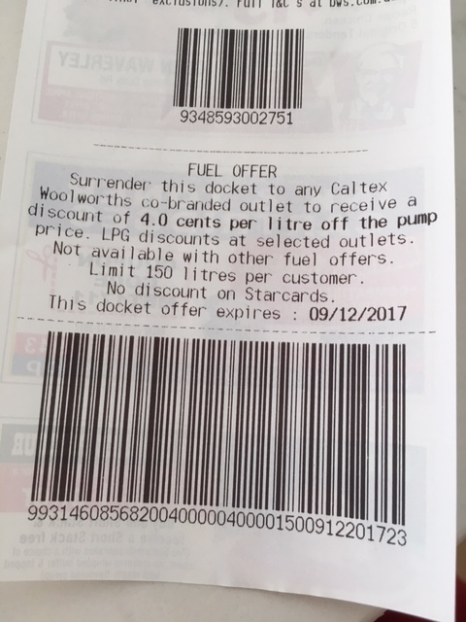
One important last thing - COUPONS
The docket (receipt) often contains what are called COUPONS
You can use a coupon to get a discount
Here is a petrol COUPON for a discount when you buy petrol for your car.
They call it a
“Fuel Offer”

